Slide 1

Presentation Lead Scoring Case Study Assignment
pramod Pandit
Sandeep Kumar

Slide 2
LEAD SCORING CASE STUDY
Table of contents
1. Introduction
2. Exploratory Data Analysis
a. Null value Calculation
b. Outlier Detection
c. Imbalance Analysis
d. Numerical Variables Analysis
e. Categorical Variables Analysis
3. Model Evaluation
a. Evaluation Metrics Definition
b. Confusion Matrix of train and test data
c. ROC Curve for train and test data
4. Conclusions

Slide 3
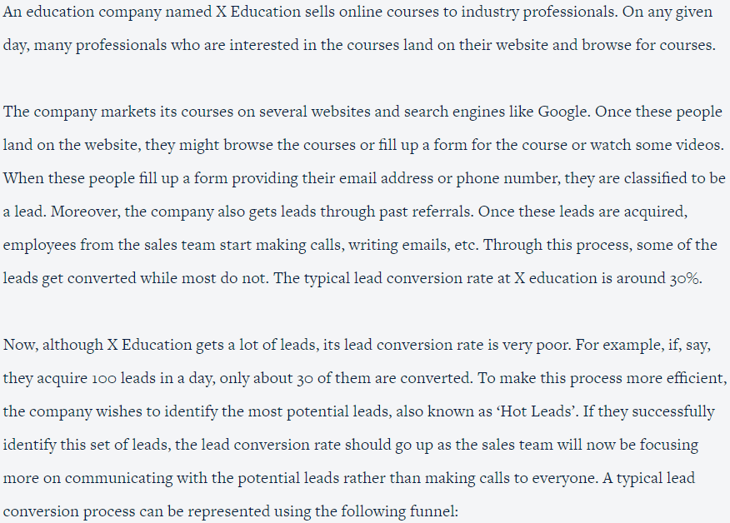
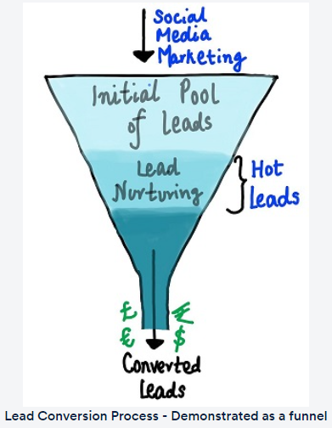
Business Objective

Slide 4
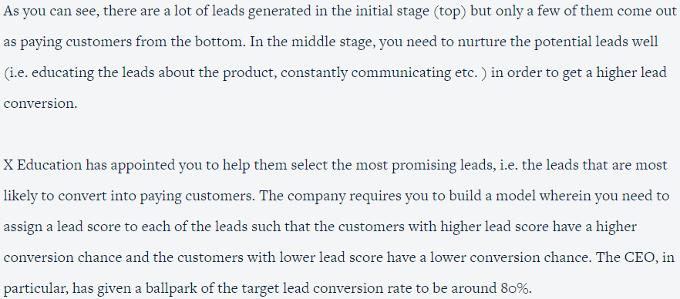
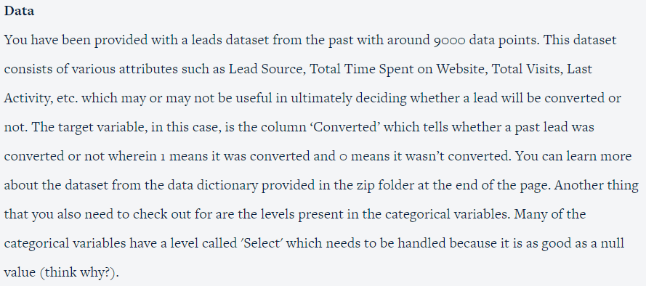
Business Objective

Slide 5
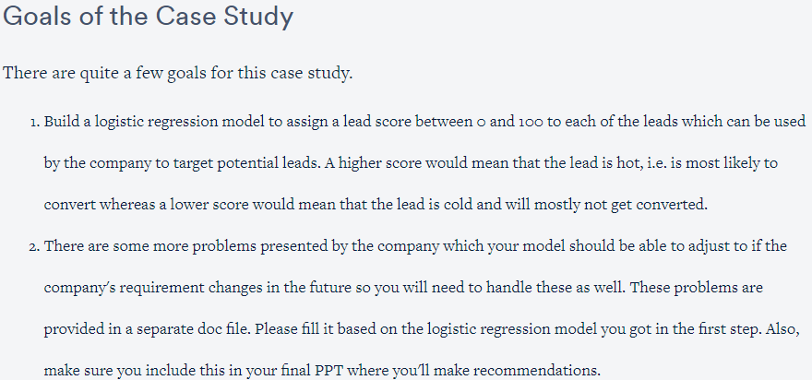
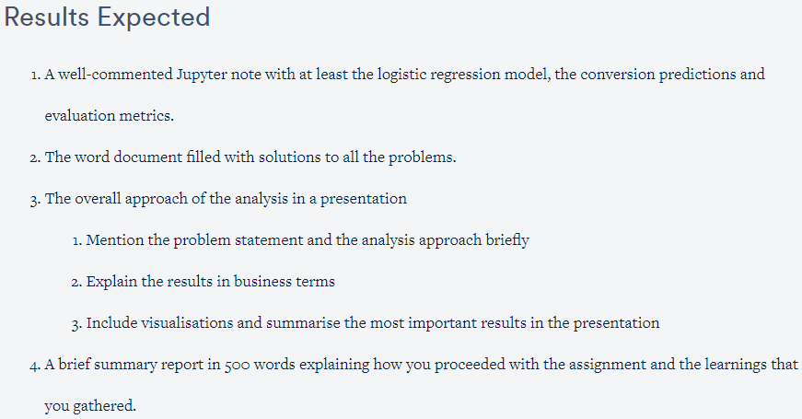
Introduction

Slide 6
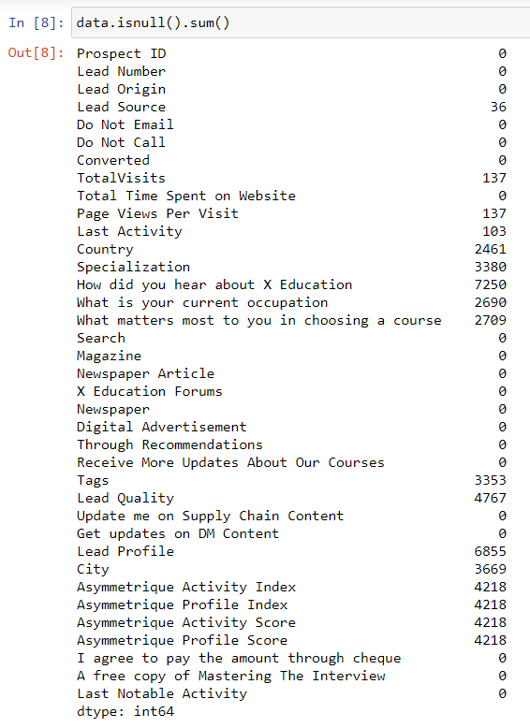
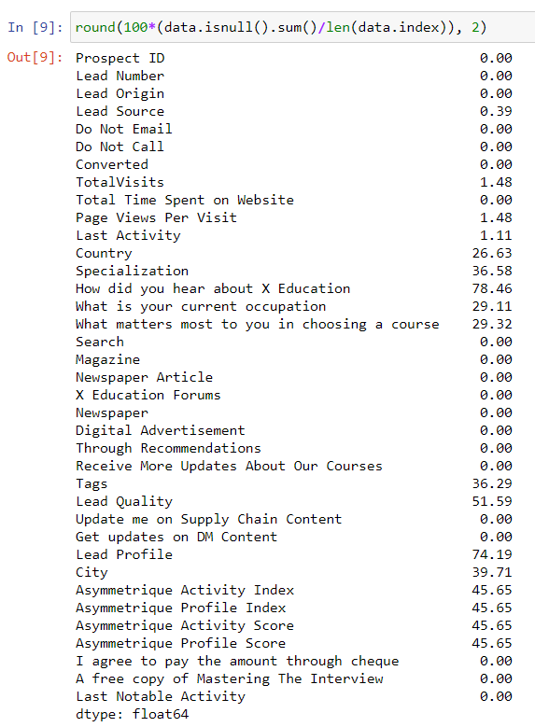
Null Value Calculation
NULL values found as above.

Slide 7
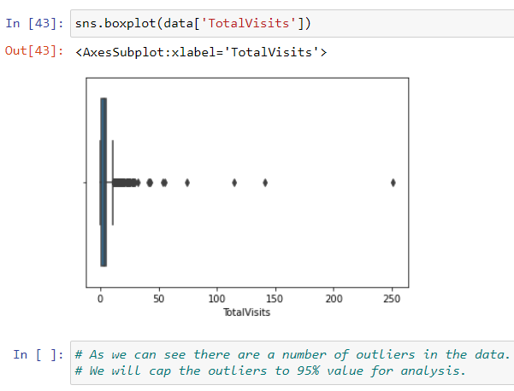
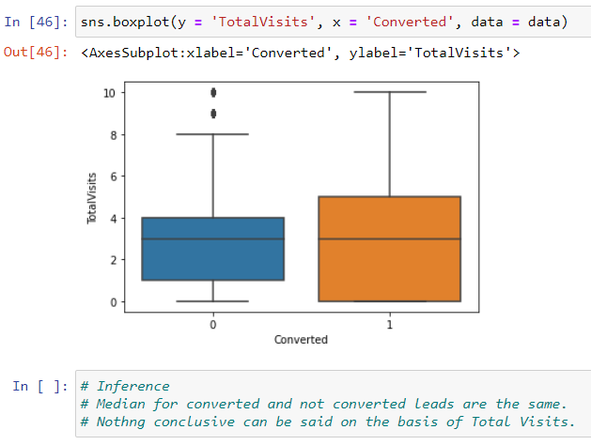
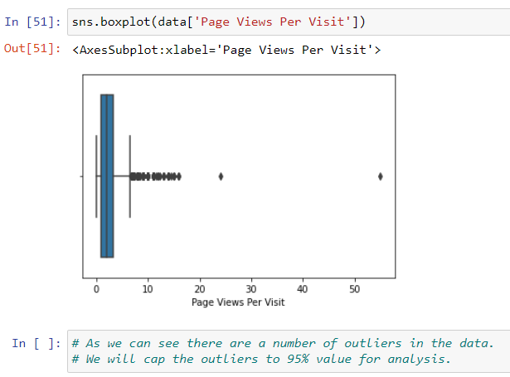
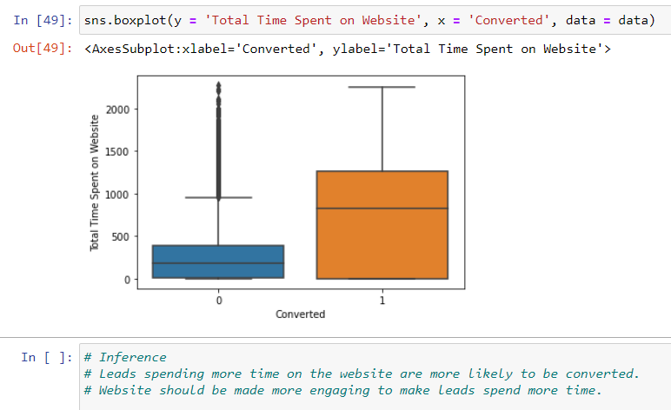
Outlier Detection
Outlier detected as above.

Slide 8
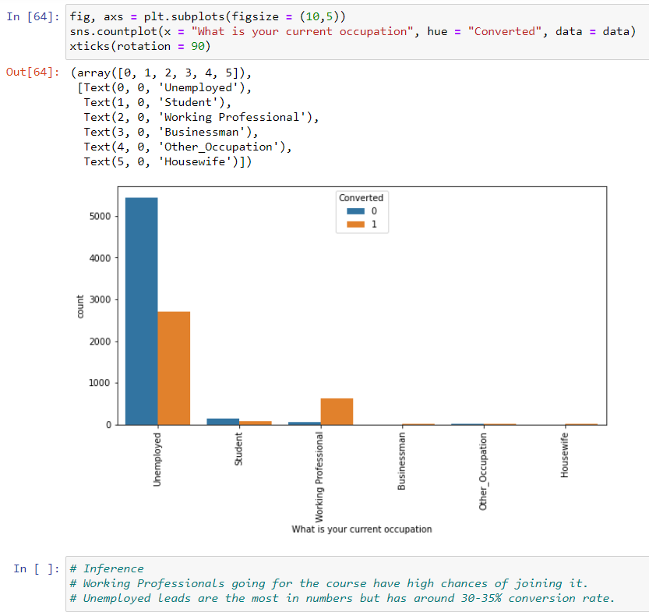
Data Analysis | Imbalance Analysis
Unemployed are most convertible.

Slide 9
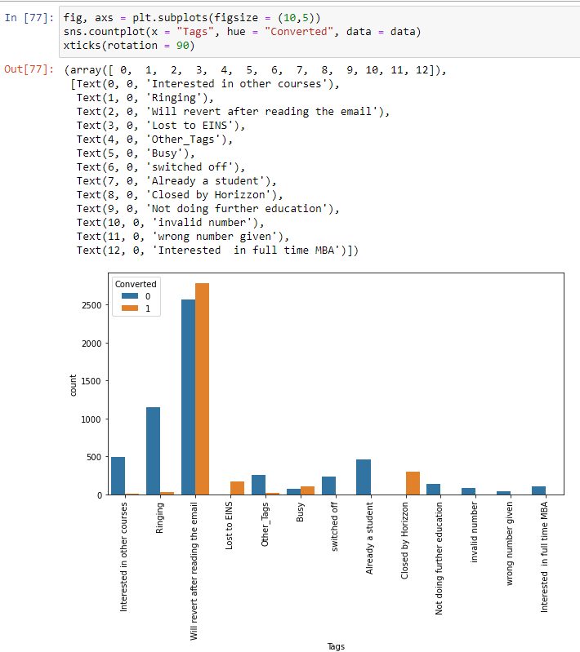
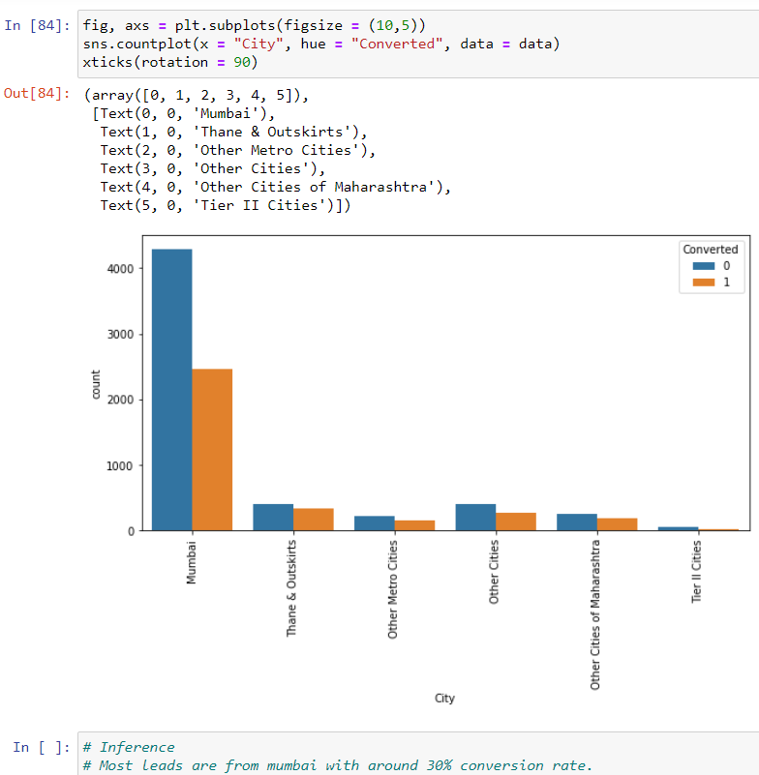
Categorical Variables’ Analysis
“Mumbai”
“Will revert after reading the email”

Slide 10
Evaluation Definitions
Predicted Negative(0) Predicted Positive(1)
Actual Negative(0) True Negative (TN) False Positive (FP)
Actual Positive(1) False Negative (FN) True Positive (TP)
Accuracy = (TP + TN)/(TP + TN + FP + FN)
Sensitivity = TP/(TP + FN)
Specificity = TN/(TN + FP)
Precision =TP/(TP + FP)
Recall = TP/(TP + FN)
F Measure (F1) = 2 * (Precision * Recall)/(Precision + Recall) TPR (True Positive Rate) = TP/(TP + FN)
TNR (True Negative Rate) = TN/(TN + FP)
FPR (False Positive Rate) = FP/(TN + FP)
FNR (False Negative Rate) = FN/(TP + FN)

Slide 11
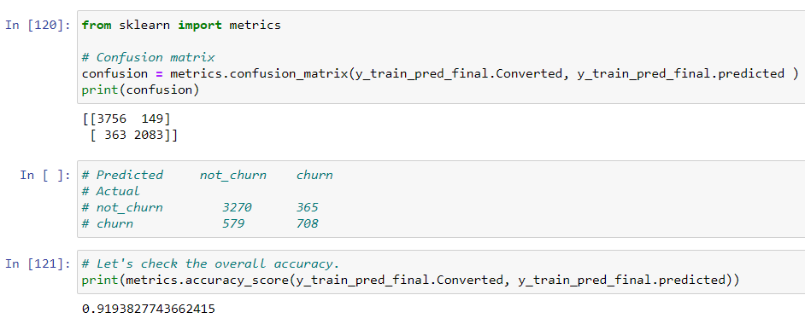
Confusion Matrix for train data
Predicted Negative(0) Predicted Positive(1)
Actual Negative(0) True Negative (TN) False Positive (FP)
Actual Positive(1) False Negative (FN) True Positive (TP)
Created Confusion matrix as above.

Slide 12
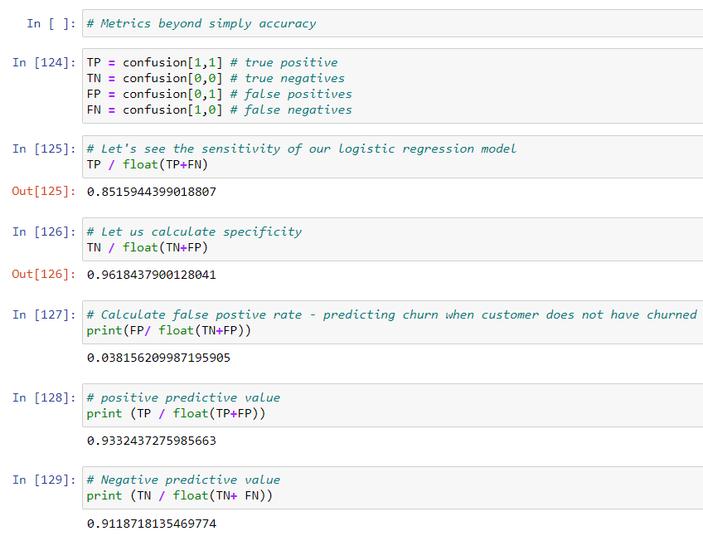
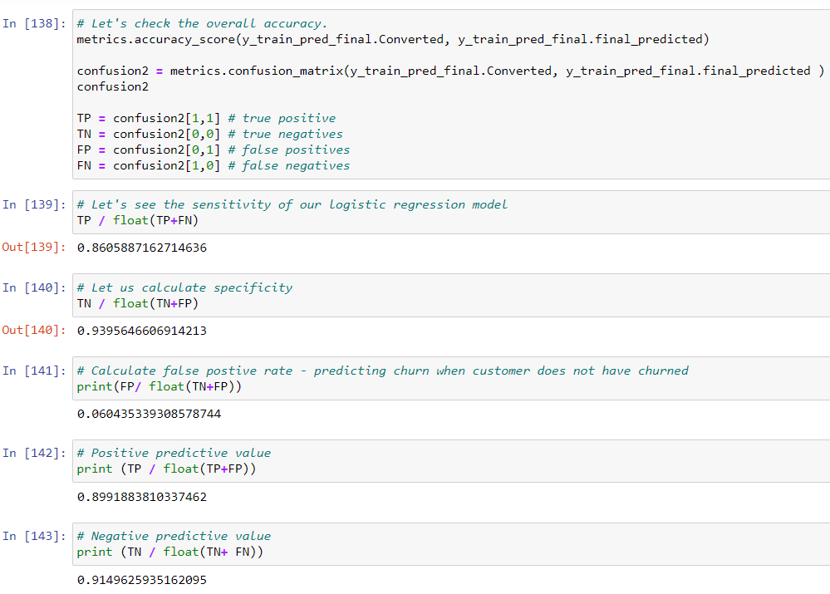
Confusion Matrix for train data
Accuracy = (TP + TN)/(TP + TN + FP + FN)
Sensitivity = TP/(TP + FN)
Specificity = TN/(TN + FP)
Precision =TP/(TP + FP)
Recall = TP/(TP + FN)
F Measure (F1) = 2 * (Precision * Recall)/(Precision + Recall)
TPR (True Positive Rate) = TP/(TP + FN)
TNR (True Negative Rate) = TN/(TN + FP)
FPR (False Positive Rate) = FP/(TN + FP)
FNR (False Negative Rate) = FN/(TP + FN)
Confusion Matrix for test data
Created Confusion matrix as above.

Slide 13
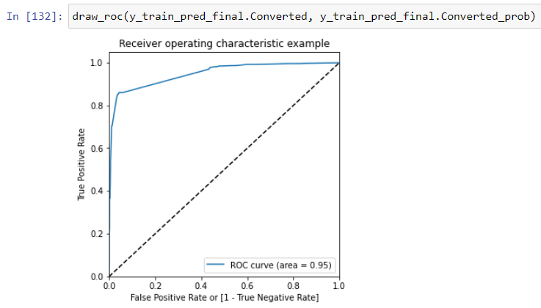
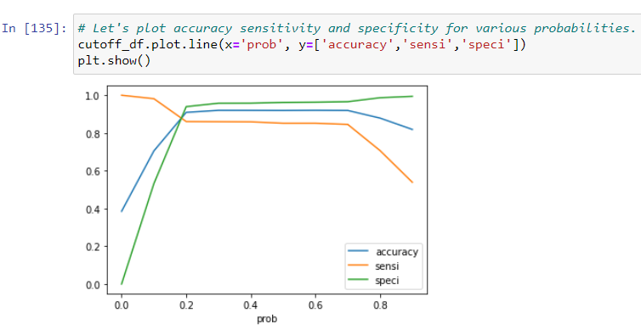
ROC Curve from data
Cut-off Point
Created ROC curve & Cut-off point as above.

Slide 14
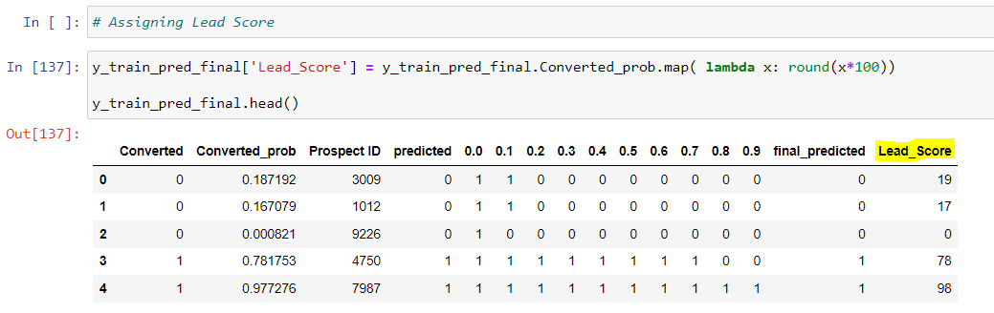
Conclusions
After analyzing the dataset and model building using logistic regression, there are few attributes of a customers (leads) with which the X Education would be able to identify the Hot Leads depending upon the lead score calculated between 0 to 100.
•We can use the lead_score column to identify which potential leads to prioritize first. The higher the score, the higher chances are there for the lead to convert. If there are limited sales representatives, then score cut-off should be higher to ensure a higher conversion probability people are contacted further to turn them into a potential customer.
•In case there are interns, then the score cut-off can be lowered. As there are more human resources, the company can afford a higher rate of False positives as it will increase the customer outreach and, in turn, increase the potential customer who will take the online courses.
•Tags were not included as predictor variable. Another model including Tags as a predictor variable can be built and segmented accordingly.

Slide 15
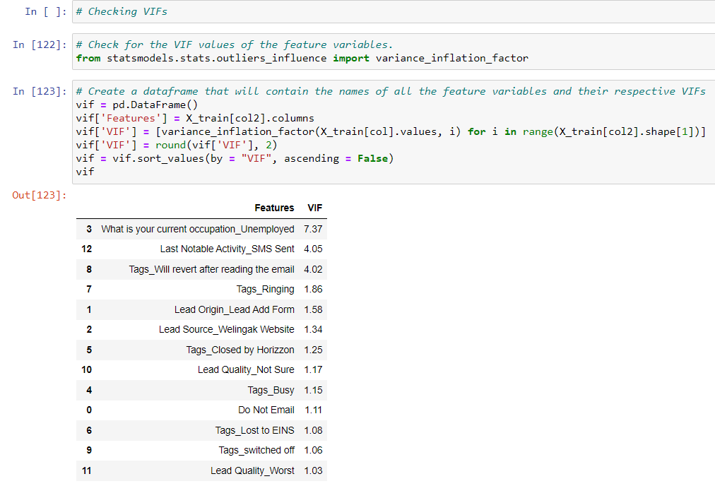
Conclusions
After analyzing the dataset and model building using logistic regression, there are few attributes of a customers (leads) with which the X Education would be able to identify the Hot Leads. The factors with relative importance are as below:
*
*
Even if VIF is higher than 5,
considering data analysis results, we have kept in the feature list.

